Slide 1

Video Game Sales Analysis

Slide 2
Dataset: Video Game Sales
Sourced from Kaggle, posted by Ulrik Thyge Pedersen
(https://www.kaggle.com/datasets/ulrikthygepedersen/video-games-sales)
Contains 16600 entries
Records games from 1980 through 2020
Each entry contains information about the game title, platform, release year, genre, publisher, and number of sales (in millions) in North America, Europe, Japan, other regions, and globally.
Some entries had missing information
Some years had negligible entries or were missing completely
2017 and 2020 had single digit entries with less than a million global sales
2018, 2019 had no entries

Slide 3
Motivations
For this project, I wanted to determine the top publishers and top genres.
I also tried to determine what genre was more profitable in general and what genre was more profitable for the top publisher.
I also focused on the Action genre and tried to fit the data to a line to predict future sales.

Slide 4
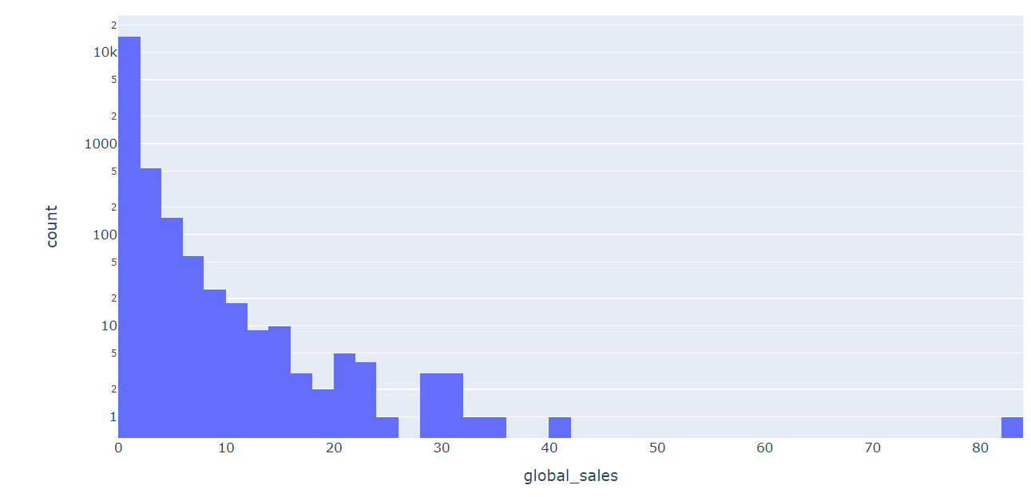
Exploring the Dataset
Histogram of global sales
Numeric summary of data does not tell us much
Mean of global sales is about 0.5607, standard deviation is about 1.5921
Majority of sales lies between 0 and 2 million sales.

Slide 5
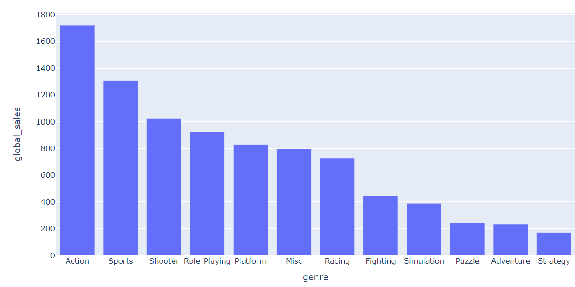
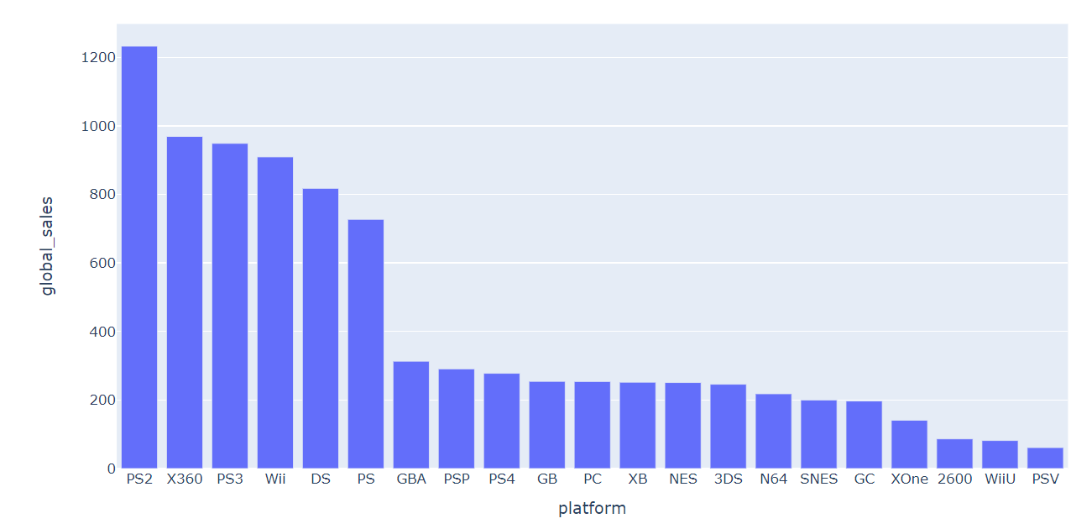
Looking at Sales
Top Genres Globally
Top Platforms Globally

Slide 6
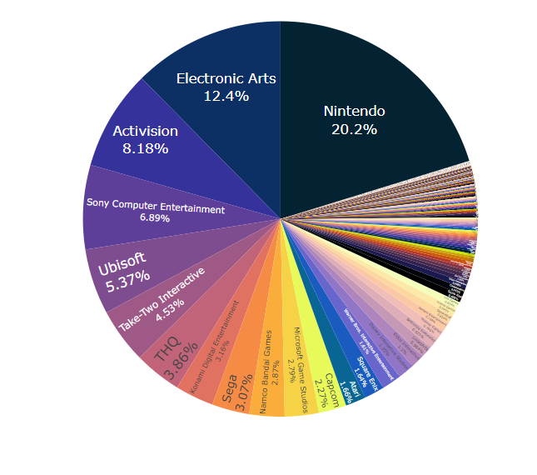
Top Publishers: Share of Global Sales

Slide 7

Action vs Sports: Permutation Test
We want to determine if Action games or Sports games are more profitable on average.
The observed difference in means was $−0.033417$ and the average of Sports games was greater.
By resampling a subset of the data with only Action/Sports games, we can determine the proportion of samples where the resampled difference in means is greater than the observed.
Result: $p=0.2478$

Slide 8

Action vs Sports: Classic Hypothesis Test
Reminder:
Null $H0$: The mean global sales of Action games is equal to the mean global sales of Sports games
$μ_{A}=μ_{S}$
Alternative $HA$: The mean global sales of Action games is less than the mean global sales of Sports games
$μ_{A}<μ_{S}$
Using a t-Test: $T=−\frac{0.033417}{\sqrt{\frac{{1.1802859}^{2}}{3148}+\frac{{2.1260558}^{2}}{2255}}}=−0.67553746$ and we get $p=0.2497$

Slide 9

Nintendo: Platformers or RPGs
Nintendo is the top publisher by global sales and its top two genres are Platformers and RPGs.
Like before, we want to determine which genre is more profitable on average, specifically for Nintendo.
In this case, the observed difference was $1.164083$ and Platform games had a higher average.
Result: $p=0.0655$

Slide 10

Platformers or RPGs: Hypothesis Test
Reminder:
Null $H0$: The mean global sales of Nintendo’s Platformer games is equal to the mean global sales of their RPG games
$μ_{P}=μ_{R}$
Alternative $HA$: The mean global sales of Nintendo’s Platformer games is greater than the mean global sales of their RPG games
$μ_{P}>μ_{R}$
As before, we use a t-Test and get $T=1.505$ and $p=0.0669$

Slide 11
Results
In our first test, we wanted to see if Sports games were more profitable compared to Action games, on average
Both tests provided very strong evidence that this was not the case
In our second test, we wanted to see if Nintendo’s Platformer games were more profitable compared to their RPG games, on average
Both tests had very marginal evidence that this was not the case

Slide 12
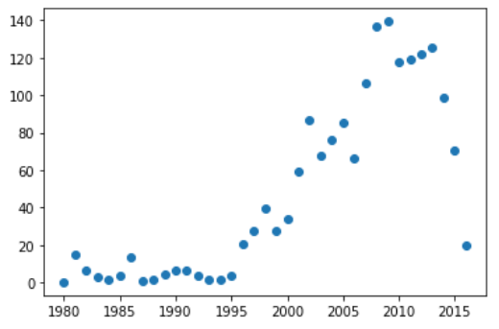
Fitting & Predicting: Linear Regression
Number of Action Games Sold Yearly (in millions)
We would like to predict the number of sales in a year for action games.
First, we’ll try fitting our data to a line, but then also look at another fit.

Slide 13
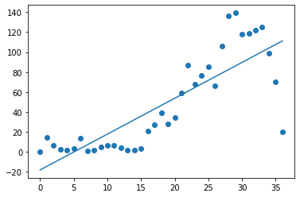

Linear Regression
$y=−18.1257468+3.5923163x$
Correlation coefficient
$r=0.8178$
Coefficient of determination
$r^{2}=0.6688$
Decent correlation, however $r^{2}$ is low so the fit is not very good.
Can also see that the sales drop towards the recent years, and a line won’t capture that.
Years since 1980

Slide 14
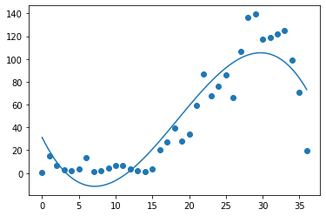
Polynomial (Cubic) Regression
The linear fit was not very good, but a polynomial fit might do better
To measure how good the fit is, we will use the squared error of the residuals and root mean squared error and compare it with the linear fit.
Years since 1980

Slide 15

Comparison
For polynomial regression, the squared error (SE) of the residuals is $12717.43$ and the root mean squared error (RMSE) is $18.54.$
For linear regression, we get $SE=26949.84$ and $RMSE=26.99$
We want the SE and RMSE to be as low as possible, so the cubic fit is better than the linear fit.

Slide 16
Conclusions
I found that the top genre, globally, is Action followed by Sports
The results of the hypothesis testing suggested that Action games aren’t more profitable on average than Sports games.
Additionally, I determined the top publisher in number of global sales to be Nintendo
And there was marginal evidence that Nintendo’s RPG games were less profitable on average compared to its Platformer games.
When I tried to fit the yearly global sales for Action games, a linear fit was poor and a cubic fit was very good.
But the cubic fit ran into a problem of overfitting

